Slide 1
Discrete system modeling and Simulation

Slide 2
In discrete systems, the changes in the system state are discontinuous and each change in the state of the system is called an event. The model used in a discrete system simulation has a set of numbers to represent the state of the system, called as a state descriptor. In this chapter, we will also learn about queuing simulation, which is a very important aspect in discrete event simulation along with simulation of time-sharing system.

Slide 3
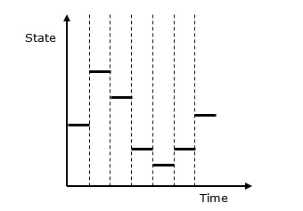
Following is the graphical representation of the behavior of a discrete system simulation.

Slide 4
Discrete Event Simulation ─ Key Features
Discrete event simulation is generally carried out by a software designed in high level programming languages such as Pascal, C++, or any specialized simulation language. Following are the five key features −
Entities − These are the representation of real elements like the parts of machines.
Relationships − It means to link entities together.

Slide 5
Simulation Executive − It is responsible for controlling the advance time and executing discrete events.
Random Number Generator − It helps to simulate different data coming into the simulation model.
Results & Statistics − It validates the model and provides its performance measures.

Slide 6
Time Graph Representation
Every system depends on a time parameter. In a graphical representation it is referred to as clock time or time counter and initially it is set to zero. Time is updated based on the following two factors −
Time Slicing − It is the time defined by a model for each event until the absence of any event.
Next Event − It is the event defined by the model for the next event to be executed instead of a time interval. It is more efficient than Time Slicing.

Slide 7
Simulation of a Queuing System
A queue is the combination of all entities in the system being served and those waiting for their turn.
Single Server Queue
This is the simplest queuing system as represented in the following figure. The central element of the system is a server, which provides service to the connected devices or items. Items request to the system to be served, if the server is idle. Then, it is served immediately, else it joins a waiting queue. After the task is completed by the server, the item departs.

Slide 8
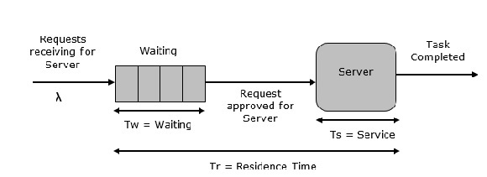

Slide 9
Multi Server Queue
As the name suggests, the system consists of multiple servers and a common queue for all items. When any item requests for the server, it is allocated if at-least one server is available. Else the queue begins to start until the server is free. In this system, we assume that all servers are identical, i.e. there is no difference which server is chosen for which item.
There is an exception of utilization. Let N be the identical servers, then ρ is the utilization of each server. Consider Nρ to be the utilization of the entire system; then the maximum utilization is N*100%, and the maximum input rate is −
$λmax = \frac{\text{N}}{\text{T}s}$

Slide 10
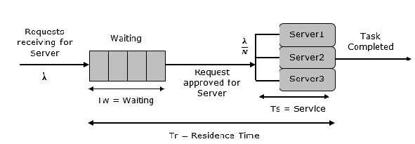

Slide 11
Simulation of Time-Sharing System
Time-sharing system is designed in such a manner that each user uses a small portion of time shared on a system, which results in multiple users sharing the system simultaneously. The switching of each user is so rapid that each user feels like using their own system. It is based on the concept of CPU scheduling and multi-programming where multiple resources can be utilized effectively by executing multiple jobs simultaneously on a system.

Slide 12
Example − SimOS Simulation System.
It is designed by Stanford University to study the complex computer hardware designs, to analyze application performance, and to study the operating systems. SimOS contains software simulation of all the hardware components of the modern computer systems, i.e. processors, Memory Management Units (MMU), caches, etc.

Slide 14
Structural data and control statements, hybrid simulation
Structural Data
Structural data refers to the way data is organized, stored, and processed in a system, particularly in simulations and computational models. It ensures efficient handling of complex information by defining relationships and constraints between data elements.

Slide 15
Types of Structural Data
Linear Data Structures
Arrays: Fixed-size collections of elements stored in contiguous memory locations. Used in numerical simulations and sensor data storage.
Linked Lists: Dynamic data structures where elements (nodes) are linked using pointers, allowing efficient insertions and deletions.
Stacks and Queues: Used in task scheduling, buffering, and event-driven simulations.
Hierarchical Data Structures
Trees: Used for representing structured data such as decision trees, XML/JSON parsing, and hierarchical simulations.
Graphs: Used in network simulations, AI pathfinding (e.g., Dijkstra’s algorithm), and social network modeling.
Tabular Data Structures
DataFrames (Pandas, SQL Tables): Used in data science and machine learning simulations.
Hash Tables: Allow fast lookup and retrieval in dictionary-like structures.

Slide 16
Role of Structural Data in Simulations
Efficient Data Handling: Optimized memory usage for large-scale simulations.
Data Interconnectivity: Ensures smooth transitions between states in hybrid systems.
Parallel Processing: Supports distributed and multi-threaded simulation models.

Slide 17
Control Statements
Control statements dictate the flow of execution in a program or simulation model. They help manage conditional decisions, looping mechanisms, and event-driven operations.
Types of Control Statements
Conditional Statements
If-Else: Executes different code blocks based on conditions.
Switch-Case: Optimized for multiple conditional checks

Slide 18
Looping Statements
For Loop: Executes a block of code multiple times (e.g., iterating over a dataset).
While Loop: Repeats execution until a condition is met (e.g., running simulations until convergence).

Slide 19
Jump Statements
Break: Exits a loop when a condition is met.
Continue: Skips the current iteration but continues the loop.
Return: Exits from a function and returns a value.

Slide 20
Event-Driven Execution
Interrupts and Triggers: Used in real-time systems for responding to external signals.
Message Passing: Implemented in multi-threaded simulations to synchronize components.

Slide 21
Role of Control Statements in Simulations
Controls Decision-Making: Manages how models react to inputs dynamically.
Handles Repetitive Computations: Automates repeated tasks such as state updates.
Enables Dynamic Behavior: Allows simulations to evolve based on real-world data.

Slide 22
Hybrid Simulation
Hybrid simulation combines discrete and continuous simulations, enabling realistic modeling of complex systems. It is widely used in cyber-physical systems, AI-driven simulations, and industrial automation

Slide 23
Characteristics of Hybrid Simulation
Continuous Dynamics: Governed by mathematical models (e.g., differential equations).
Discrete Event Transitions: Controlled by logic-based triggers and state changes.
Hybrid Controllers: Combines software-based algorithms with real-time control hardware

Slide 24
Applications of Hybrid Simulation
Cyber-Physical Systems (CPS)
Smart Grids: Models power distribution, real-time energy consumption, and control responses.
IoT-Based Smart Cities: Simulates traffic flow, waste management, and public services.
Autonomous Vehicles
Hybrid simulation integrates real-time sensor feedback with AI-driven decision-making.
Examples: Self-driving cars (Tesla Autopilot, Waymo).

Slide 25
Biomedical and Healthcare Simulations
Simulating drug interactions with biological systems using hybrid pharmacokinetics models.
Example: COVID-19 spread simulations combining discrete patient interactions with continuous disease progression models.
Industrial Automation & Robotics
Models robotic arm movements with real-time control feedback.
Example: Factory automation systems (Siemens, ABB Robotics).

Slide 26
Continuous system modeling and Simulation
A continuous system is one in which important activities of the system completes smoothly without any delay, i.e. no queue of events, no sorting of time simulation, etc. When a continuous system is modeled mathematically, its variables representing the attributes are controlled by continuous functions.

Slide 27
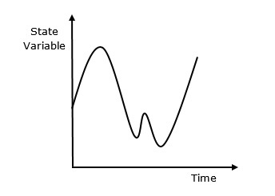
What is Continuous Simulation?
Continuous simulation is a type of simulation in which state variables change continuously with respect to time. Following is the graphical representation of its behavior

Slide 28
Why Use Continuous Simulation?
We have to use continuous simulation as it depends on differential equation of various parameters associated with the system and their estimated results known to us.
Application Areas
Continuous simulation is used in the following sectors. In civil engineering for the construction of dam embankment and tunnel constructions. In military applications for simulation of missile trajectory, simulation of fighter aircraft training, and designing & testing of intelligent controller for underwater vehicles

